Slide 1
Regional Disaster Finance Program
Notes:
As emergency managers in the state of Texas, we tend to concentrate on mitigating, preparing and responding to emergencies from an operational perspective. Seldom do we do the same for the fiscal side of emergency management, with areas such as recovery often being an afterthought. With today’s economy, fiscal responsibility needs to be considered at the beginning of the emergency, not at the end.
Finance is part of all four areas of emergency management (mitigation, planning, response and recovery) and we should be concerned with much more than just how to respond to an emergency
Introductions
Name
Position (Daily and during a Disaster)
Disaster Experience
Course Expectation
Instructor
LASTE UPDATED:
5 November 2015

Slide 2
Purpose
Facilitates collaboration and communication between disaster responders and financial managers prior to an emergency occurring.
Promoting financial responsibility
Equipping jurisdictions with the tools necessary to track, calculate and justify the costs of an emergency.

Slide 3
Focus
Analyze accounting practices of finance departments during a disaster and/or emergency.
Review best practices of other departments.
Develop SOPs to be followed during a disaster and/or emergency.
Develop a process of calculating a “daily burn rate” for executive staff.
Develop a process for filing for reimbursement
Understand how this burn rate connects to county thresholds during a major disaster declaration.
Notes:
This class is about focusing on your jurisdiction’s current policies, determining how they differ in a disaster event, and what (if any) changes, need to be made. This is your class. Be interactive and make it your own.

Slide 4
T-600 Course
The T-600 course is an in-depth analysis of the financial capabilities of each jurisdiction during a disaster or emergency. It will:
Analyze the accounting practices of individual finance departments during disasters and emergencies by reviewing accounting systems.
Identify gaps in policies and procedures when accounting for a disaster or emergency.
Establish financial standard operating procedures (SOPs) to be used during a disaster.
Exercise financial SOPs.
Notes:
Facilitator Questions for Group:
Analyze current procedures; identify gaps; and develop policies to address gaps
Focuses on declaration numbers and reimbursement, but very few are declared.
Need to develop sound practices that are always followed for disaster finance management.
Follow the same practices and tracking methods whether reimbursement will occur or not.
Thresholds
County Threshold – monetary amount that must be met to be eligible for Public Assistance Funding; city and county expenses for a combine total
State Threshold – State compiles total expenses from counties to meet their threshold and ask for a formal federal disaster declaration for additional funding.

Slide 5
Course Objectives
Analyze accounting practices of finance departments during a disaster and/or emergency.
Review best practices of other departments.
Develop SOPs to be followed during a disaster and/or emergency.
Develop a process of calculating a “Daily Burn Rate” for executive staff.
Understand how this burn rate connects to county thresholds during a major disaster declaration.
Develop a process for filing for reimbursement (FEMA or state).
Notes:
Daily burn rate. The cost of responding to a disaster. DON’T GLOSS OVER THIS!
Explain it and explain what it is all about.
The end result is the creation of a Financial Daily Burn Rate (the Cost of the Incident thus for) your jurisdiction. It can be shared with Executive Mgmt. and the State of TX. This will allow key Executives to make financial decisions regarding the incident before it becomes costly to the jurisdiction. It also helps: ensure that the proper documentation is obtained so that the reimbursement process is seamless and fewer dollars are de-obligated.
Thresholds: Counties and States must reach a designated threshold to be eligible to receive a Disaster Declaration and thus, be eligible for disaster related grant funds.
TDEM – the SOC needs this information so they can make strategic decision.
Meeting Key Thresholds
FEMA bases its government relief programs on a yearly-revolving formula
Public Assistance is determined by using the following formula
CPI adjusted to COUNTY PER CAPITA INDICATOR by
(Fiscal Year Oct 1 - Sept 30)
$3.57 (2016 CPI) x County 2010 census number =
$County Wide Threshold
What is your jurisdiction’s/agencies process for filing for reimbursement? Is it written down?

Slide 6
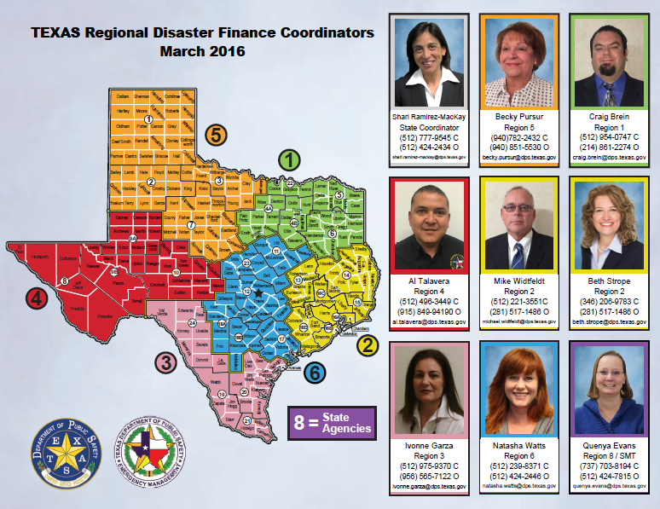
Notes:
A part of the Recovery, Mitigation, and Standards Section of the Texas Division of Emergency Management.
Overseen by a state coordinator
8 finance coordinators stationed throughout the state
1 each in DPS Regions 1, 3, 4, 5, and 6
2 in DPS Region 2
1 DPS Headquarters (Region 8) in Austin to assist state agencies
Emphasize limitations of program, size of group
Quick overview of deployment process:
If a disaster occurs jurisdictions can request for us to help out with the tracking of costs.
The jurisdiction can submit/activate us (Coordinators) through a Star request with your DC.

Slide 7
Example

Slide 9
FY 2016 State Declaration Threshold (at 1.41/Capita)
$35,455,241
FY 2016 Texas County Thresholds (at $3.57/Capita)
COUNTY CENSUS 2010 DESIGNATION
NAME POPULATION THRESHOLD
Region 3 - DDC-20 – Corpus Christi
Aransas County 23,158 $82,674 Bee County 31,861 $113,744
Brooks County 7,223 $25,786
Duval County 11,782 $42,062
Jim Hogg County 5,300 $18,921 Kennedy County 416 $1,485
Kleberg County 32,061 $114,458
Live Oak County 11,531 $41,166
Nueces County 340,223 $1,214,596
Refugio County 7,383 $26,357
San Patricio County 64,804 $231,350
Example
Notes:
Even if a county will not meet their threshold, it is important to track and report because it can help the State hit their overall threshold and help in providing assistance to others.

Slide 10
Daily Burn Rate vs. Reimbursement (Bonus Slide)
Daily Burn Rate
Public Assistance Reimbursement
Track ALL COSTS associated with the event
Reported daily
Mechanism for capture of raw data in real time
Provide situational awareness for event
Example
Costs that are ABOVE AND BEYOND daily operations
Need declaration
Can use daily burn rate data to calculate
Specific cost categories
FEMA / TDEM forms
Notes:
Daily Burn Rate
What is the daily cost of managing the incident each day
Need to Report to state daily before 10 am
State reports chief’s / governor’s office by 10 am
Local Daily Burn Rates are requested by the SOC to gain greater situational awareness, better understand the impact of the event, and assist / influence decision making and preparation for managing the event.
This is NOT a DSO although much of the data may be used in developing your DSO.
What is a DSO? (Damage Summary Outline)
Initial document for requesting State and Federal Recovery Assistance
Form for collecting Initial Damage Estimates to assist in determining scope of disaster
TDEM Damages Record Collection Tool
State can track early incident trends to determine if the incident might be declarable and they can initiate process to request funding earlier, expediting the overall incident.
What is the Public Assistance Program?
The Public Assistance (PA) Program provides supplementary Federal assistance to State, local, and tribal governments, and certain private nonprofit organizations. The PA Program awards grant funding to assist these participants in the response and recovery activities generated by a disaster.
Funding is cost shared at a Federal share of no less than 75 percent of the eligible costs incurred as a direct result of a declared disaster. When conditions warrant, and if authorized by the President, 100 percent Federal funding may be awarded for a limited period of time.
Public Assistance Reimbursement: FEMA has divided disaster-related work into two broad Categories of Work.
Emergency Work and Permanent Work.
Emergency Work – Includes Category A – Debris Clearance and Category B – Emergency Protective Measures
Permanent Work – Includes Categories C – Roads and Bridges, Cat. D – Water Control Facilities, Cat. E – Building and Equipment, Cat. F- Public Utility Systems, Cat. G- Other Type of Facilities (Recreational Facilities, Airports, etc.)

Slide 11
Daily Burn Rate
Repairs
Leases
Personnel Cost
Equipment Cost
Other
Travel Cost
Commodities
Contracts
Food
Fuel
Daily Cost Tracking Report
Notes:
State generates Daily Burn Rate (DBR) / event cost at 10 am each day.
What does your time line look like?
What is your cut off time for labor and costs?
What is your turn around time for generating report to county / state?
What timeframe are you reporting? (Generally report previous 24 hour cycle so you have time to compile numbers)
Choose a timeline and cut off, inform the agency you are reporting to, and stick to it. ( Can’t be 48hr lag one day, 24hr lag the next … we need you to report with consistency)
Day one may be off, but after day one follow your adopted policies for reporting cycles.

Slide 12
T-600 Course Overview
Accounting System
Time
Procurement
Contracts
Equipment
Risk Management
Resource tracking
Overview by emergency manager on operations (ICS vs. ESF)
Review of ICS structure
Review of the finance section in ICS structure
Review state reimbursement forms
Notes:
Facilitator Questions for Group: These are the topics are the course,
Disbursement and accounting records documenting costs incurred include:
Force account labor records (payroll information and timesheets).
Force account equipment usage and rate schedule.
Material usage from inventory.
Records of donated labor, materials, and equipment.
Contracts or contractor bids.
Rental and lease agreements.
Invoices, warrants, and checks.
Inspection/monitoring logs.
Mutual Aid
Do you have mutual aid contracts that cover a certain time frame (12 hours, 24 hours, etc.) before there is an expectation of reimbursement? Note: these time frames may not be compensated.

Slide 13
ICS ORGANIZATIONAL CHART
Notes:
This is what is going on and where you sit in the big scheme of things….
Explain briefly what each section does. You are here…..
Ask them if they know where they sit in their EOC?
Who works for us?
Finance works closely with Logistics
– where does your Procurement person sit – Logistics or Finance?
Explain to them that these are the questions we will be able to answer once we get through this class.
The Finance Section is often the LAST section staffed during a disaster. We are trying to change that mindset and teach a jurisdiction to bring their finance team in early.
The sooner proper tracking can occur the sooner proper estimates of the disasters impact can be made.
This effort may lead to greater opportunities for classifying an incident a disaster and thus open up reimbursement opportunities sooner and with greater funds recovered.
15 Minute Break should be 9:30 am

Slide 14
Finance Section Chief
Roles and Responsibilities
Operating Plan Worksheet

Slide 15
Time Unit Leader
Personnel and Equipment Spreadsheet

Slide 19
Overview of the PA Program Process
Notes:
This slide is hyperlinked and you can get the FEMA basic over for PA Program Process by clicking on the slide title.
OR
Go to: IS-634 Introduction to FEMA’s Public Assistance Program
The PA Program is authorized by the Stafford Act.
44 Code of Federal Regulations (CFR) Part 206, Subparts C and G through L. Additional pertinent regulations set forth in 44 CFR include:
Part 9—Floodplain management and protection of wetlands.
Part 10—Environmental considerations.
Part 13—Grant administration and allowable costs.
PA Guidance available at: www.fema.gov/government/grant/pa/policy.shtm FEMA 321 Public Assistance Policy Digest. Easy-to-read, brief summary of Public Assistance Program policies. FEMA 322 Public Assistance Guide. Describes provisions and application procedures for Public Assistance Program grants. FEMA 323 Applicant Handbook. Questions and answers on how to apply for Public Assistance Program grants.
Applicants have 30 days following the declaration or area designation to request Public Assistance using the RPA form.
Kickoff Meeting
Upon receipt of the Request for Public Assistance form, a PAC Crew Leader is assigned to the applicant. The PAC Crew Leader schedules a kickoff meeting with the applicant and the State. The meeting focuses on the eligibility and documentation requirements of the applicant. Discussions include:
Specific project formulation and documentation.
Funding options pertinent to the applicant.
Special considerations that may affect the funding.
The kickoff meeting is a one-on-one session that establishes the partnership among FEMA, the State, and the applicant.

